Slide 1
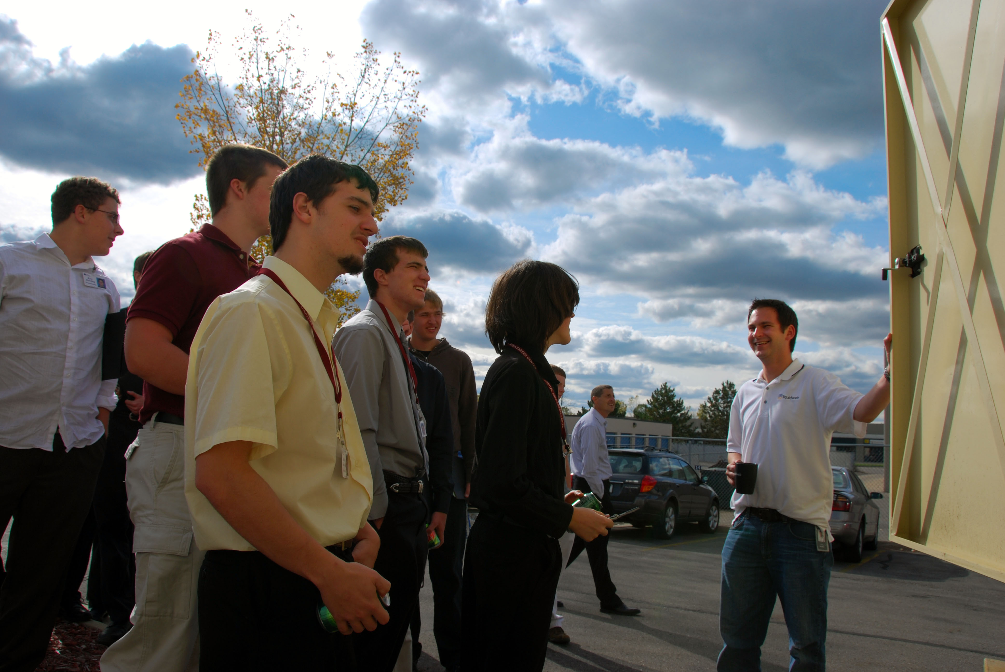
Dean Transportation will provide a way for us to travel from business to business.
We depart from the International Center at 12:00PM and return around 6:00PM.
Reserve your spot by emailing Chris Knapp at cknapp@camw.net
OCT 28 2011
Housing Tour of Motor Wheel Lofts
Business Tours of Accident Fund, Michigan Department of Technology, Management & Budget and Spartan Internet Consultants
Socializing and Networking event at
The Boardroom
TECH TOUR
www.youtube.com/watch?v=5Q8FhQiqpt0

